Slide 1
FRMS Update
“Actio”: Open-Source Transaction Monitoring System
October 2022 Greg McCormick Johanne Foley
Executive Director Head of Engineering
FRMS CoE FRMS CoE
greg@frms.io johannes@frms.io
Johannes.Foley@sybrin.com

Slide 2
A reminder of why we built the
Fraud Risk Management Solution
Actio – Transaction monitoring system
1

Slide 3
Why?
Why an Open Source TMS?
The Problem
How It Works
Implementation & Maintenance
Governance
Need and purpose.
Because Mojaloop needed anti-fraud, AML, CTF products that work with it?
Well, that’s true. But there are other reasons. (This works with more than Mojaloop)

Slide 4
Why an Open-Source Fraud Risk Management System?
Why an Open Source TMS?
The Problem
How It Works
Implementation & Maintenance
Governance
Fraud is a major issue—and it’s getting worse
“With more than 4.5 billion people online, more than half of humanity is at risk of falling victim to cybercrime
at any time, requiring a unified and strong response.”
Jürgen Stock,
INTERPOL Secretary
General
Fraud is expensive for:
Those who are defrauded
The system – defending against fraud costs tremendous amount to each player in the ecosystem
Government, both dealing with their own fraud, and helping others to defend against it.
Impacts of Fraud
Based on international estimates, public bodies generally lose between 0.5% and 5% of their spending to fraud and related loss.
The private sector fears reputational impact and does not generally disclose, but according to Merchant Savvy, global losses of payment fraud have tripled to $32.39 billion in 2020 and are expected to continue to cost $40.62 billion in 2027 which is 25% higher than in 2020.
Therefore, the increase in fraud cases restrains the growth of the payments markets and financial inclusion, and this largely ignores informal markets.
Dramatic Cost Savings
Open source is source code that is made freely available for modification and redistribution. Products include permission to use the source code, design documents, or content of the product. The OSS model is a decentralized software development model that encourages collaboration. A main principle is is peer production, with products such as source code and documentation freely available to the public.
$$$
Human
Government Outcomes
Reputational
Government Systems
Industry
Environmental
Security
Financial
Business
International Public Sector Fraud Forum Guide to Understanding the Total Impact of Fraud February 2929
Notes:
Explain why we built this.

Slide 5
A specific need for financial institutions
Why an Open Source TMS?
The Problem
How It Works
Implementation & Maintenance
Governance
Budgets are limited, needs are high.
Smaller organizations are frequently forced to “make do” with what they have or solutions that are sub par.
Significant barrier to entry for start ups and those focusing on financial inclusion.
Transactional monitoring systems are expensive because they are hard
To build and hard
To implement
We have significantly reduced the Total Cost of Ownership by providing an Open-Source Solution.

Slide 6
Fraud Risk Management System Landscape
Why an Open Source TMS?
The Problem
How It Works
Implementation & Maintenance
Governance
Governance Risk and Compliance (GRC)
Risk Management
Reporting (regulatory, management)
Administrative
Batch
Real Time
Assessment
Policy Management
Compliance
Identity Management (KYC, Sanctions, UBO)
Anti-Money Laundering /Counter Terror Financing
Non-real-time
Transaction Monitoring – Fraud, AML, CTF
(Real-Time, Near Real-Time, Batch)
Notes:
The focus area

Slide 7
Actio OSS Transaction Monitoring System: High level description
Why an Open Source TMS?
The Problem
How It Works
Implementation & Maintenance
Governance
An Open-Source Solution for Fraud and Risk Management
This is the Transaction Monitoring System
Includes the 30+ highest-priority fraud typologies
The most difficult component
(real-time capabilities, many moving parts, integration with other systems)
Implementable by DFSPs, Software Publisher and payment networks
Designed for low-cost operation
It works in concert with other components of a comprehensive fraud program
KYC/UBO, Investigation, GRC Programs
Designed to scale up and down to suit needs and costs
Notes:
30 most …
Typologies are patterns of fraud
Built to work with what you already have for systems and data
So, all of your kyc and ubo information, what you have in your risk mitigations systems like block lists.

Slide 8
How it works a reminder
Why an Open Source TMS?
The Problem
How It Works
Implementation & Maintenance
Governance
An Engine Only
Low cost and Open Source.
Payment switches resell to your FSPs for additional revenue streams.
Payment switches leverage data sharing for better fraud decisions.
Designed to be used by anyone and modified for their own needs or as the plumbing of a solution offered by a commercial entity.
Scales up to run as country-wide payment switches, banks, or payment networks
API driven
Highly configurable by Json message
Scales down to run in the smallest and most limited of situations
Modular and adapter driven both for data/events in and data/events out to the line of business systems and case management system
** Embed the Actio Solution into your environment, customizing to your needs
Notes:
This is an engine only and designed to work in your environment.
We have provided easy to use hooks to integrate with your alerting system or case management system for investigation purposes.
Scale up to run for the largest enterprise, and scale down to run on a laptop
It is hard enough to create something that can run at scale just as hard to create something that can scale down and run lean.
We‘ve built a system that does both.
To keep you on the right side of personal information laws ,,
We do pseudonymization in the system to no expose PII data, but we did not implement all of the controls and processes necessary to implement GDPR or similar programs.
A reminder:
Personally Identifiable Information (PII) - Information that, when used alone or with other relevant data, can identify an individual. This information that can be used to get a person’s identity, location, or contact details

Slide 9
Status Updates:
2

Slide 10
Accomplished
Why an Open Source TMS?
The Problem
How It Works
Implementation & Maintenance
Governance
Completed to date
Not Everything
We’ve
Been Busy
MVP Complete April
FRMS CoE ”Theoretically Created”
Implementation of Neutral Systems for
Documentation
Code
Access Control Defined
Completion of conversion to CoE Neutral Systems
Approved Messaging
Planning of Convening for potential testers
Identification of potential early adopters
One Commercial Fork Already with customers.
The great UX debate
Created 1 OSS CMS Integration
Sybrin to allow evaluators and testers to use their more complete UX

Slide 11
To do
Why an Open Source TMS?
The Problem
How It Works
Implementation & Maintenance
Governance
Some of what there is to do …
Not Everything
There Will
Be More
Underway, what OSS Group do we fall under?
Creation of the actual Center of Excellence, governance et al
Funding partnerships actively being sought
Initial Implementations
Potentials So far – 5
Performance Case Study
Potential Guidebooks
How to implement, Analysis and Typologies
Typology accuracy testing with FCA Synthetic and Real Data
Match Implementations Needs to Product Roadmap (and Build)
Refinement of mission based on market and funder inputs
Much later in the year look for synergies
Consumer Protection Mappings
To support Regulators

Slide 12
Technical deliverables
3

Slide 13
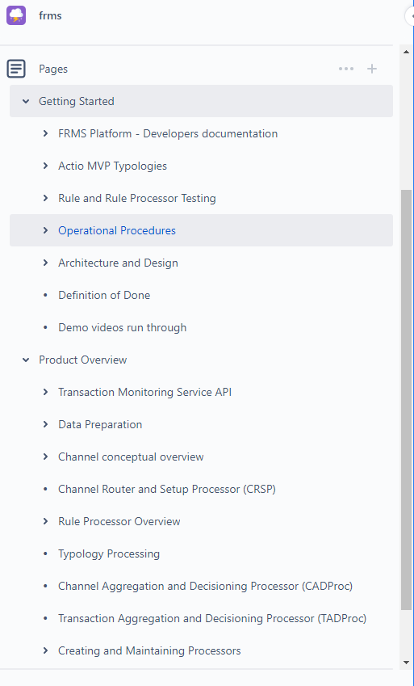
deliverables
Why an Open Source TMS?
The Problem
How It Works
Implementation & Maintenance
Governance
Create FRMS CoE
Implementation of the FRMS CoE, Systems, Governance, Access Control:
Create neutral CoE for FRMS code repositories - https://github.com/FRMSCoE
Create neutral CoE for FRMS document repositories - https://frmscoe.atlassian.net/wiki/home
Create neutral CoE for FRMS CI/CD pipeline
Define operational procedures
Creation of the Payment Platform Adapter for Mojaloop
Integrate with 1 OSINT data source for sanctions - FIC
Integration with Case Management Systems for investigations:
Open-source CMS: Nuxeo
Commercial CMS: Sybrin
On-boarding:
Thitsaworks, Glenbrook, Mifos and Converge Solutions have all shown interest and has been on-boarded to the new CoE controlled repositories

Slide 14
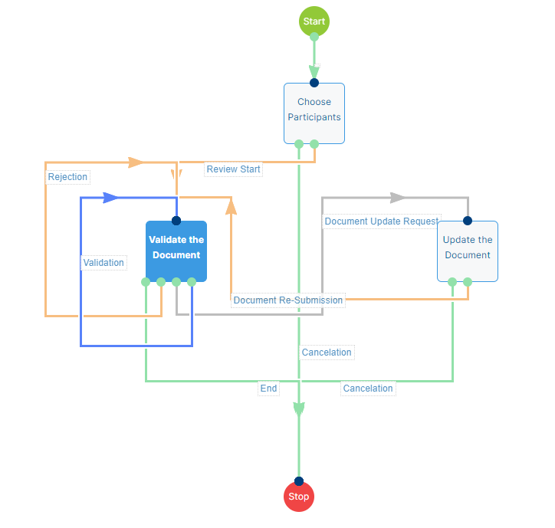
Investigation flow
Why an Open Source TMS?
The Problem
How It Works
Implementation & Maintenance
Governance
Nuxeo OSS Case Management

Slide 15
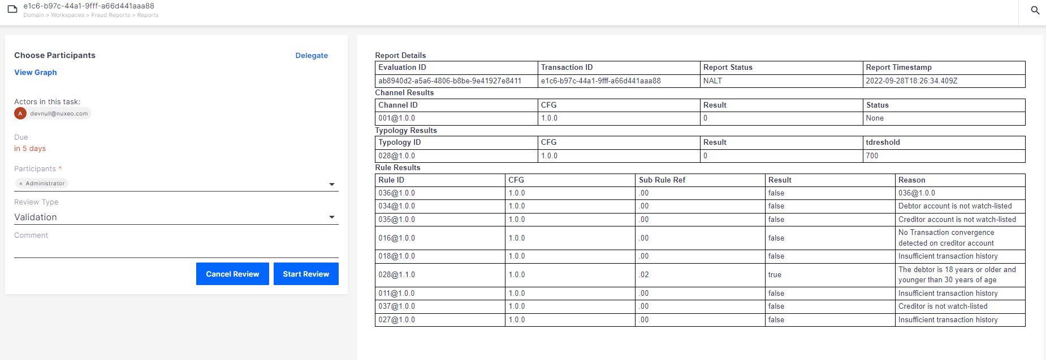
Assign participants
Why an Open Source TMS?
The Problem
How It Works
Implementation & Maintenance
Governance
Nuxeo OSS Case Management

Slide 16
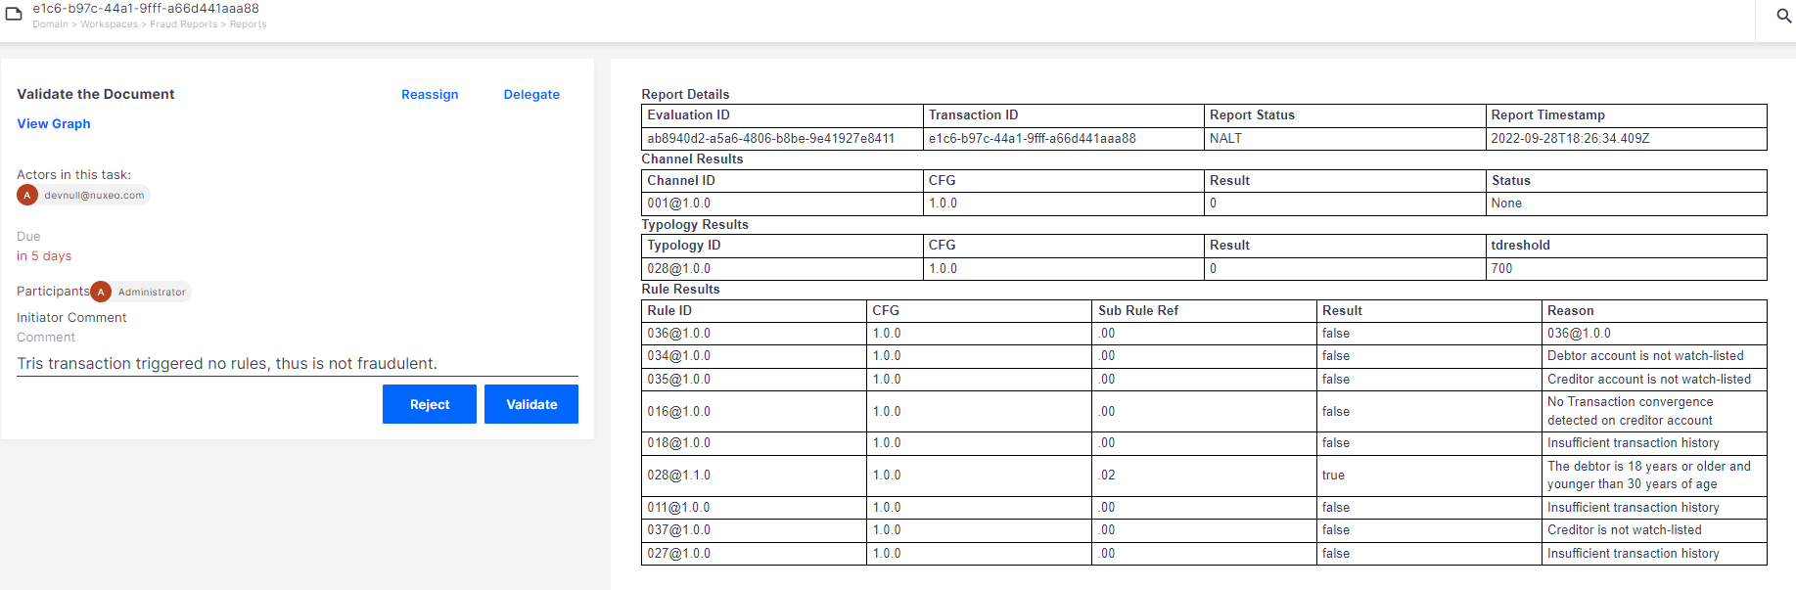
investigate
Why an Open Source TMS?
The Problem
How It Works
Implementation & Maintenance
Governance
Nuxeo OSS Case Management

Slide 17
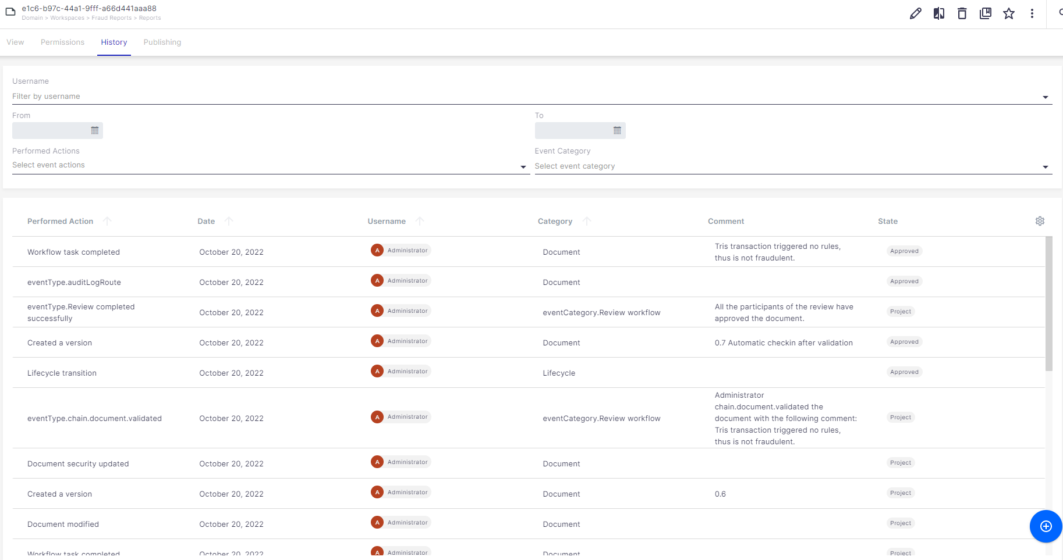
Case history
Why an Open Source TMS?
The Problem
How It Works
Implementation & Maintenance
Governance
Nuxeo OSS Case Management

Slide 18
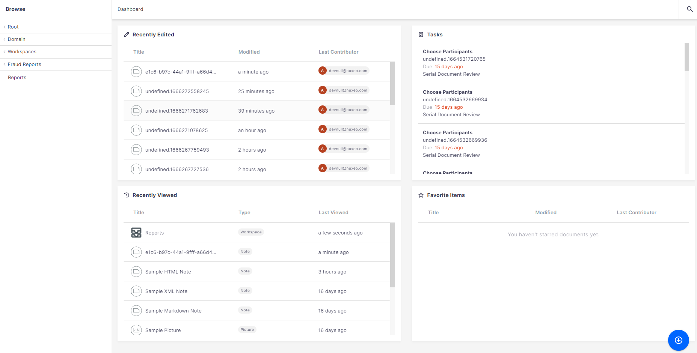
Dashboard
Why an Open Source TMS?
The Problem
How It Works
Implementation & Maintenance
Governance
Nuxeo OSS Case Management

Slide 19
What’s next - Performance
Why an Open Source TMS?
The Problem
How It Works
Implementation & Maintenance
Governance
Performance benchmark
Optimizations
Scale up components - Nifi, Arango (from standalone to cluster), Redis, ELK (convert to cluster deployment)
Performance testing (run performance test at scale to aim to achieve 3000 tps)
Benchmark
Requirements for 3000 tps
Minimum spec required to run Platform
Cost / cloud requirement Estimate per 1k tps (eg 1k, 2k, 3k)
Propose optimized infrastructure architecture document for > 3k tps
Scaling of processors in OpenFaas (force up / down scaling of a processor)
System sizing-related performance - Costs for 3000 tps & Minimum cost
Endurance test
A 3 day real world scenario, that fluctuates the load e.g. (Idle at 50 TPS, medium load of 800 TPS, and peak load of 3,000 TPS)
Ability to provide a short and repeatable test scenario demonstrating the performance metrics.
Create test data that will contain representative volumes of fraud for each typology. Ideally reach a 1% fraud rate triggering the different typologies on a repeating dataset of ~10 000 transactions

Slide 20
Index
5

Slide 21
Typologies – Patterns of fraud
Why an Open Source TMS?
The Problem
How It Works
Implementation & Maintenance
Governance
The Typology Life Cycle
Example: Typology No. 28, Scams
003@1.1.0 | Account Dormancy - Creditor
008@1.0.0 | Outgoing Transfer Similarity - Creditor
010@1.0.0 | Increased Account Activity - Debtor
011@1.0.0 | Increased Account Activity - Creditor
016@1.0.0 | Transaction Convergence - Creditor
018@1.0.0 | Exceptionally Large Outgoing Transfer
021@1.0.0 | A Large Number of Similar Transaction Amounts - Creditor
025@1.0.0 | Aggregated Transaction Mirroring
027@1.0.0 | Immediate Transaction Mirroring
028@1.1.0 | Debtor age
030@1.0.0 | New Creditor transfer
034@1.0.0 | Watch-listed account - Debtor
035@1.0.0 | Watch-listed account - Creditor
036@1.0.0 | Watch-listed party - debtor
037@1.0.0 | Watch-listed party - creditor
048@1.0.0 | Large transaction amount vs history - Debtor
063@1.0.0 | Synthetic data check - Benford's Law - Creditor
Develop the Rules
Compose the Typology
Deploy the Typology
Calibration

Slide 22





A User Story
Why an Open Source TMS?
The Problem
How It Works
Implementation & Maintenance
Governance
Users act, rules are assessed, and you look for patterns of fraud, or typologies.
Etana convinces Adamu, Bingwa and Chege that they’d won a prize and need to pay a small administration fee to process their winnings.
A. They each transfer the money to Etana’s account.
(Amounts are very similar for each transaction).
B. As each payment arrives, Etana immediately cashes out the payment.
C. Adamu’s payment arrives after the money agent has closed for the day so Etana immediately transfers his payment to her associate, Dume.
D. Dume cashes out the payment first thing the next morning.
A
Electronic Funds Transfer
Adamu
Mobile Money
B
B
RTP
Gateway
Cash Out
C
Etana
A
Agent System
Electronic Funds Transfer
Bingwa
Bank
C
D
A
Cash Out
Cash Deposit
Dume
Chege
Money Remitter

Slide 23
Do the actions show a pattern of fraud?
Why an Open Source TMS?
The Problem
How It Works
Implementation & Maintenance
Governance
Typology
Rules
Alert
Example
Typology 28: False promotions, phishing, or social engineering scams.
(e.g. fraudsters impersonating providers and advising customers that they have won a prize in a promotion and to send money to the fraudster’s number to claim the prize).
003@1.1.0 | Account Dormancy - Creditor
008@1.0.0 | Outgoing Transfer Similarity - Creditor
010@1.0.0 | Increased Account Activity - Debtor
011@1.0.0 | Increased Account Activity - Creditor
016@1.0.0 | Transaction Convergence - Creditor
018@1.0.0 | Exceptionally Large Outgoing Transfer
021@1.0.0 | A Large Number of Similar Transaction Amounts - Creditor
025@1.0.0 | Aggregated Transaction Mirroring
027@1.0.0 | Immediate Transaction Mirroring
028@1.1.0 | Debtor age
030@1.0.0 | New Creditor transfer
034@1.0.0 | Watch-listed account - Debtor
035@1.0.0 | Watch-listed account - Creditor
036@1.0.0 | Watch-listed party - debtor
037@1.0.0 | Watch-listed party - creditor
048@1.0.0 | Large transaction amount vs history - Debtor
063@1.0.0 | Synthetic data check - Benford's Law - Creditor
X
X
X
!
X
X
X
Enough Rules were Broken that a Fraud Alert was Triggered
Notes:
Walk through the patterns
Patterns equal typologies
We are still protecting our typologies and have to work out access.
The Deloitte project that happened earlier on identified 232 main typologies.
For the MVP we enabled 32

